Slide 1
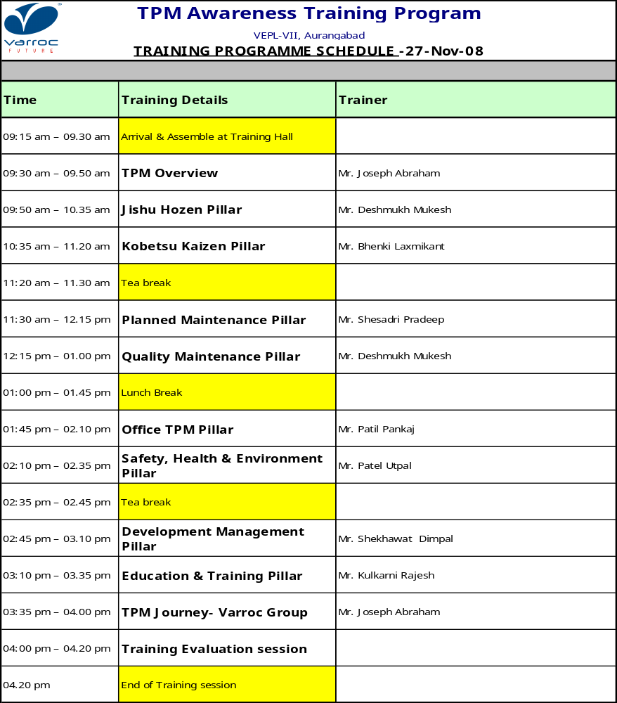

Slide 2

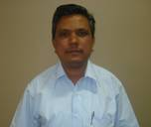
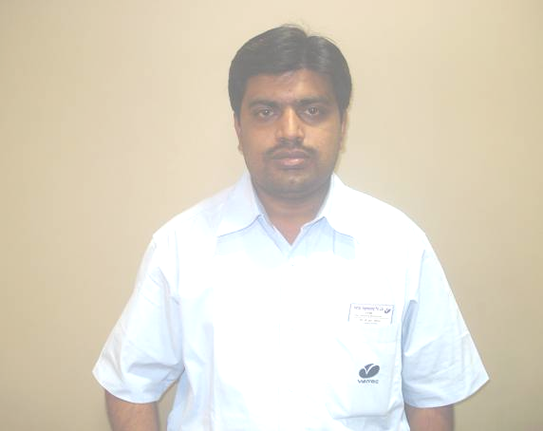
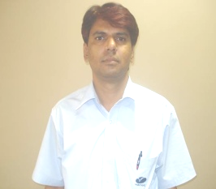
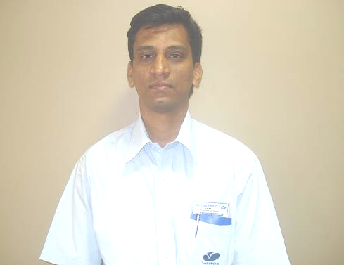
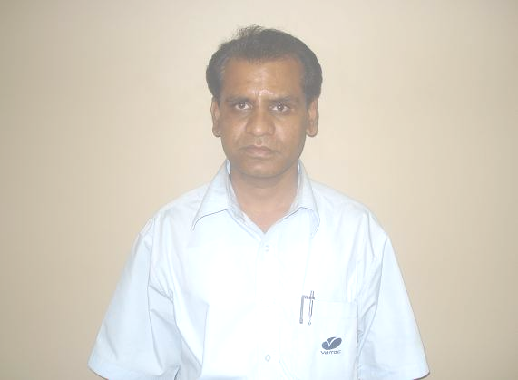
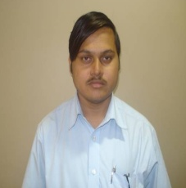
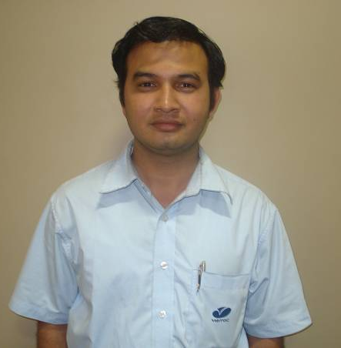

TPM TRAINERS TEAM
Joseph
Sheshadri
Mukesh
Pankaj
Bhenki
Patel
Dimpal
Sachin
Rajesh

Slide 3

TPM Overview

Slide 4
History of TPM

Slide 5
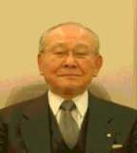
Seiichi Nakajima
“The Pioneer of TPM”
Since the introduction of PM, the predecessor of TPM, to Japan in 1951, Seiichi Nakajima has dedicated over half century to influence the concept of PM and TPM as a leader, and continues to this day. In these days, increasing numbers of TPM Award winners in overseas evidence that over 50 years of his committed effort is a genuine and valuable dedication to not only the Japanese manufacturing industry but also for manufacturing industry all over the world.
Without his remarkable effort, TPM and manufacturing industry would not have been what it is today.

Slide 6
Progress of TPM in Japan
Years
Key-words
Explanation
Before
1950s
Breakdown maintenance
Repair after failure by the person in charge of repair
Management of equipment is not considered
1950s
Preventive maintenance
Preventive maintenance of equipment by the person in charge of maintenance
Economical maintenance control
1960s
Productive maintenance
Management of total equipment life (equipment planning, maintenance, improvement, revision) by the person in charge of equipment from the economical point of view
1970s
TPM in production department (Manufacturing industry)
Production maintenance by all members related to equipment planning, operation and maintenance
1980s
Company wide TPM (whole industry)
TPM activity by all members related to production, development, business, and management, etc.
1990s
Global TPM
Global and general TPM activity including local production
2000s
TPM in unmanned operation plants
TPM development in unmanned operation plants.

Slide 7
History of TPM and the Present Style
TPM is a unique Japanese systems of managerial expertise .
(Maintaining plants/ equipments)
Developed from PM (preventive maintenance)
style of US in 1950s.
Subsequently developed to its present state by JIPM
Now, TPM promotes entire company structures every line of businesses and all parts of the world.
TPM is implemented company wide.

Slide 8
Why TPM ?

Slide 9
Implementation of TPM Is Changing the Mindset of the Organization

Slide 10
Need for Change
Organizational change is needed in order to align the company with changing business environment.
There are external and internal factors which necessitate the Change.

Slide 11
External and Internal Factors
External factors:
Market volumes, changing product profile, competition on price and variety, stringent product specifications, change in business environment driven by government Policies etc.,
Internal factors:
skills of employees, present plant technologies with respect to future product specifications driven by customers, level of productivity, Quality, cost and morale of employees.

Slide 12
Change
Customer orientation
Products
Processes
People processes
People skills
Leadership Decisions
From
Company driven
Minimum defects
Output inspection
Individual effort
Delegation
Managing
by pass problem
Unilateral
To
Customer driven
Zero defects
Input setting
Team effort
Empowerment
Leading
Solution
Consultative /
Empowered

Slide 13
Offence & Defense
Offence Job | Defense Job
New Product New Customer New Technology New Factory Merger and Acquisitions New - Gambling Investment | Product Improvement - Customer Complaint Zero - Defect Zero - Breakdown Zero - Accident Zero - Education and Training - Vendor Development Cost Reduction --- Sustenance --- Not new, not investment

Slide 14
Speed up and Cost Reduction
Customer
Marketing
Each Division
Between 2 ~3 Division
Headquarters
Planning
Finance
Personal
etc
R & D
Production
Material

Slide 15
Japanese Case
Indian Case
 Sub-Assembling
Big sized company
S
Toyota
M
S
S
Denso Aisin
Big sized company
1st Supplier
Big sized company
Very rare
2nd Supplier
Medium sized company
M
M
S
S
3rd Supplier
Small sized companies
S
Direct Business
Direct Dispatch
4th Supplier
Tiny sized companies

Slide 16
What is TPM ?

Slide 17
What is TPM?
Total Profit Management
…………………Company Survives
Total Production Management
………………… ISO, TQM, JIT, Re-Engineering
Total Perfect Manufacturing
…………………. Loss Elimination
Total Productive Maintenance and Management

Slide 18
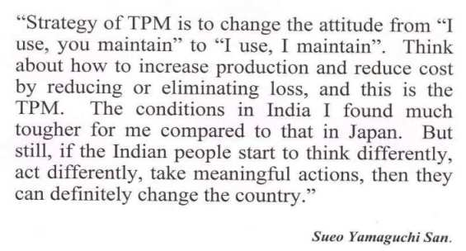
This is TPM….

Slide 19
Definition of TPM ( Production TPM)
What is TPM?
1. To set a goal to maximise equipment efficiency (overall efficiency).
2. By establishing a total system for PM for the entire life of equipment.
3. Participation by all departments, including equipment planning, operating and maintenance departments.
4. Involving all personnel, including top personnel to first-line operators.
5. For promoting PM by motivation management, namely, by autonomous small-group activities.

Slide 20
Definition of TPM (Company-wide TPM)
What is TPM?
1. Taking as a prime objective a company structure that pursues production efficiency to its ultimate limits
(= comprehensive efficiency)
2. Putting together a practical shop-floor system to prevent losses before they occur throughout the entire production system’s life cycle: zero accidents, zero defects, zero breakdowns etc
3. Involving all functions, including production, development, sales and management
4. Having all employees participate, from top executives to frontline workers
5. Achieving zero losses through overlapping small groups

Slide 21
From TPM of Production Department to Company-wide TPM Covering All Company Activities
Top Management
Planning
Financial
Personnel
General Affairs
Administrative
Production
Development of products & equipments
Sales
Plant
Plant
Plant
Plant
TPM Phase 1
TPM Phase 2
TPM Phase 1 TPM of Production Department
TPM Phase 2 Company-wide TPM encompassing production,
development, sales and administration

Slide 22
Company wide TPM
1. TPM aims to create a corporate system that maximizes the efficiency of the production system (overall efficiency improvement)
2. TPM creates systems for preventing the occurrence of all losses on the f2€ line and is focused on the end product. This includes systems for realizing "zero accidents, zero defects, and zero failures" in the entire life cycle of the production system
3. TPM is applied in all sectors, including the production, development, and administration departments,
4. TPM is based on the participation of all members, ranging from the top management to frontline employees.
5. TPM achieves zero losses through overlapping small-group activities.

Slide 23
12 Steps for TPM Implementation

Slide 24
12 Steps in 4 Stages
1. Introduction – preparatory stage: steps 1 to 5
2. Start of introduction: step 6
3. Introduction – execution stage steps 7 to 11
4. Establishment stage: step 12

Slide 25
12 Steps for TPM Implementation
Introduction-preparatory stage
Step 1: The top person's declaration of the resolve to introduce TPM
The declaration is made in an internal TPM lecture meeting, and should
be printed in an internal bulletin or newsletter.
Step 2: TPM introduction education.
Managerial staff: Staff of the same echelon are scheduled together for
training General employees: Slide-show meetings
Step 3: Formation of TPM promotion organizations and formal organizational
models Committees, specialized subcommittees, promotion secretariat
Formal organization models
Step 4: Setting of basic TPM principles and targets
Benchmarks and targets; prediction of effects
Step 5: Preparation of a master plan for implementing TPM
From preparation for introduction to undergoing examinations

Slide 26
12 Steps for TPM Implementation
Start of introduction
Step 6: Kick off of TPM
Customers, affiliated companies, and cooperative companies are invited

Slide 27
12 Steps for TPM Implementation
Introduction-execution stage
Step 7: Establishment of a system for improving the efficiency of the production department
Pursuit of improvement of efficiency in the production department
7.1: Kobetsu-Kaizen
Project-team activities and workshop small-group activities
7.2: Jishu-Hozen
Step method, diagnosis, and approval certificates
7.3: Planned maintenance
Corrective maintenance, periodic maintenance, predictive maintenance
7.4: Operation/maintenance skill development
Collective education of leaders & education concerning transmission of
education to members

Slide 28
12 Steps for TPM Implementation
-Execution stage
Step 8: Establishment of initial phase management systems for new products & new
equipment Development of easy-to-manufacture products and easy-to-use equipment
Step 9: Establishment of quality maintenance systems
Creation of conditions in which defects do not occur, and the maintenance/management
of those conditions.
Step 10: Creation of systems for improvement of the efficiency of administrative/supervisory
sectors.
Production support, improvement of the efficiency of related sectors, and improvement
of efficiency of equipment.
Step 11: Creation of systems for the control of safety, health, and the environment
Creation of systems for zero accidents and zero pollution cases
Establishment stage
Step 12: Complete implementation of TPM and level improvement
Undergoing examinations for the receipt of PM awards; Setting sights on higher targets.

Slide 29
Typical TPM Organizational Chart
President
TPM Promotion Office
Plant Manager
Company wide TPM Promotion committee
Plant TPM promotion committee
Section TPM promotion committee
Foreman TPM promotion committee (Leader Meeting)
Small group formed on the production floor (PM circle)
“Kobetsu-Kaizen” sub-committee
“Jishu-Hozen” sub-committee
Section Chief
Planned maintenance sub-committee
Sub-Section Chief
Initial flow control sub-committee
“Hinshitsu-Hozen” sub-committee
Supervisor
Office improvement sub-committee
Front-line Worker
Education and training sub-committee
Safety and hygiene sub-committee

Slide 30
Effectiveness of TPM
P…..Productivity improvement ---------------------------------------------- 1.5 to 2 times
Reduction in Number of Equipment Failures ----------------------- 0 to 1/250
Q ….. Reduction in Product Defects ----------------------------------------- 0 to 1/100
Reduction in Customer Claims -------------------------------------- 0 to 1/10
C ….. Reduction in Manufacturing Cost ------------------------------------- 20 to 50%
Reduction in Maintenance Cost --------------------------------------- 30%
D ….. Reduction in Product Inventories -------------------------------------- 0 to 1/10
S ….. Reduction in Accident, Elimination of Pollution ------------------ 0
M ….. Increase in Number of Employee Suggestions -------------------- 5 to 10 times

Slide 31
Effectiveness
Tangible Effectiveness
Productivity
Quality ( Customer Complaint, Defect )
Cost
Inventory Dispatch adherence
Accident
Moral

Slide 32
Intangible Effectiveness of TPM
1. After introduction of autonomous maintenance activity, operators take care of machines by themselves without being ordered to.
2. With achievement of zero breakdowns and zero defects, operators get new confidence in their own abilities.
3. Workplaces that used to be covered with oil and chips are now so clean and pleasant as to be almost unrecognisable.
4. Improved image of the company, leading to the possibility of increased orders.

Slide 33
With TPM-Activity
KI CK
OF F
No TPM activity
With TPM activity
Result Drastically
3 2 1
Year
1 2 3

Slide 34

TPM 8 Pillar Approach
TPM
Individual Improvement
(Kobetsu Kaizen)
Autonomous Maintenance
(Jishu Hozen)
Planned Maintenance
(Keikaku Hozen)
Quality Maintenance
(Hinshitsu Hozen)
Education & Training
Development Management
Safety, Health & Environment
Office TPM

Slide 35
5 PRINCIPLES IN TPM DEVELOPMENT
1. Establish the system to achieve production efficiency.
1.1 “Kobetsu-Kaizen”
1.2 “Jishu-Hozen”
1.3 Planned maintenance
1.4 Education and training for operation and maintenance skill upgrade
2. Establish initial production and flow control system for new products and equipment.
3. Establish the “Hinshitsu-Hozen” ( QM ) system.
4. Establish the system to realize operation efficiency in the administration department.
5 Establish safety, hygiene and working environment protection systems.

Slide 36
Purpose and Main
Activities of the 8 Pillars
of TPM

Slide 37
Individual Improvement
Purpose:
Realize zero losses of all types, such as failure losses and defect losses
Demonstrate ultimate production efficiency improvement
Members:
Staff
Line Leader
Activities:
Understanding the 16 major losses
Calculating and settling goals for overall equipment efficiency, productivity and production subsidiary resources
Implementation of PM analysis
Thorough pursuit of equipment and production “as it should be”.

Slide 38
Autonomous Maintenance
Purpose:
Training of operators proficient in equipment
Protecting one’s own equipment by one’s staff
Members: Operator, Line Leader
Activities:
Implementation of 7 steps
1. Initial clean-up
2. Countermeasures for the source of problems and measures for difficult-to- access locations
3. Creation of tentative autonomous maintenance standards
4. General inspection
5. Autonomous inspection
6. Standardization
7. All-out goals management

Slide 39
Planned Maintenance
Purpose:
Improving efficiency of maintenance departments to ensure reliability
and maintainability of equipments
Members:
Staff
Leader and maintenance men of maintenance department
Activities:
Daily Maintenance
Time Based Maintenance
Condition Based Maintenance
Improvement for increasing the service life expectancy
Control of replacement parts
Failure analysis and prevention of recurrence.
Lubrication control

Slide 40
Quality Maintenance
Purpose:
Achieve zero defects by supporting and maintaining equipment conditions
Members: Quality assurance Staff, Production engineering staff, Line Group Manager
Activities:
Verify quality characteristics standards; understand defect phenomena and performance
Investigating the conditions for building in quality, unit processes and raw materials, equipment and methods
Investigating, analysing and improving the conditions of malfunctions
Setting 3M conditions; setting standard values for inspection
Creation of standards that can be followed; trend management

Slide 41
Development Management
Purpose:
Reducing product development and prototyping time
Reducing the development, design and fabrication time of equipment
Improving 1-shot start-up stability of products and equipment
Members: Research and development staff, Production engineering staff, Maintenance staff
Activities:
Setting development and design goals
Ease of production
Ease of QA Implementation
Ease of use
Ease of maintenance
Reliability
Investigate LCC
Design release drawing
Production: Identify problems in the prototype, trial run and initial-phase mass production control stages.
Reflect in MP design

Slide 42
Office TPM
Purpose:
Achieve zero function losses
Creation of efficient offices
Implementation of service support functions for production departments
Members:
Leaders and members of administration/Indirect departments
Activities:
Autonomous maintenance activities
1. Initial clean-up (personal space)
2. Work inventory
3. Countermeasure for problems
4. Standardization
5. Promotion of autonomous management activities of work
Individual improvement through project activities
1. Shortening of settlement schedule
2. Improvement of distribution
3. Improvement of purchasing and subcontracting
4. Reform of production control system

Slide 43
Education and Training
Purpose:
Establishment of technical education for operations and maintenance workers
Members:
Operators
Maintenance workers
Activities:
Basic process of maintenance
Tightening nuts and bolts
Aligning keys
Maintenance of bearings
Maintenance of conductive parts
Prevention of leaks
Maintenance of oil pressure and air pressure equipment
Maintenance of electrical control equipment

Slide 44
Safety and Health
Purpose:
Achievement and support of zero failures
Realization of a healthy and invigorating workplace that gives meaning to work
Members:
Safety, health and environment managers and specialised committee members
Staff specialising in safety and health
Activities:
Measures to improve equipment safety
Measures to improve work safety
Improvement of work environment (noise, vibration and odors)
Measures to prevent pollution
Creation of healthy employees
Promotion of invigorating activities

Slide 45
Customer Requirement
TPM 8 Activities
Individual Improvement
Autonomous Maintenance
Planned Maintenance
Quality Maintenance
Development Management
Office – TPM (Marketing, Purchasing, etc)
Education and Training
Safety, Health and Environment
Quality
Delivery
Cost

Slide 46







8 Activities and Loss
KOBETSU
KAIZEN
SAFETY, HYGIENE,
ENVIRONMENT
JISHU HOZEN
LOSS
OFFICE
TPM
PLANNED
MAINTENANCE
QUALITY
MAINTENANCE
EDUCATION &
TRAINING
DEVELOPMENT
MANAGEMENT

Slide 47
TPM Vs TQM
Category | TQM | TPM
Object | Quality ( Output and effects ) | Equipment ( Input and cause )
Means of attaining goal | Systematize the management. It is software oriented | Employees participation and it is hardware oriented
Target | Quality for PPM | Elimination of losses and wastes.

Slide 48


Who gets more benefited by TPM?
CUSTOMERS
COMPANY
Employees

Slide 49
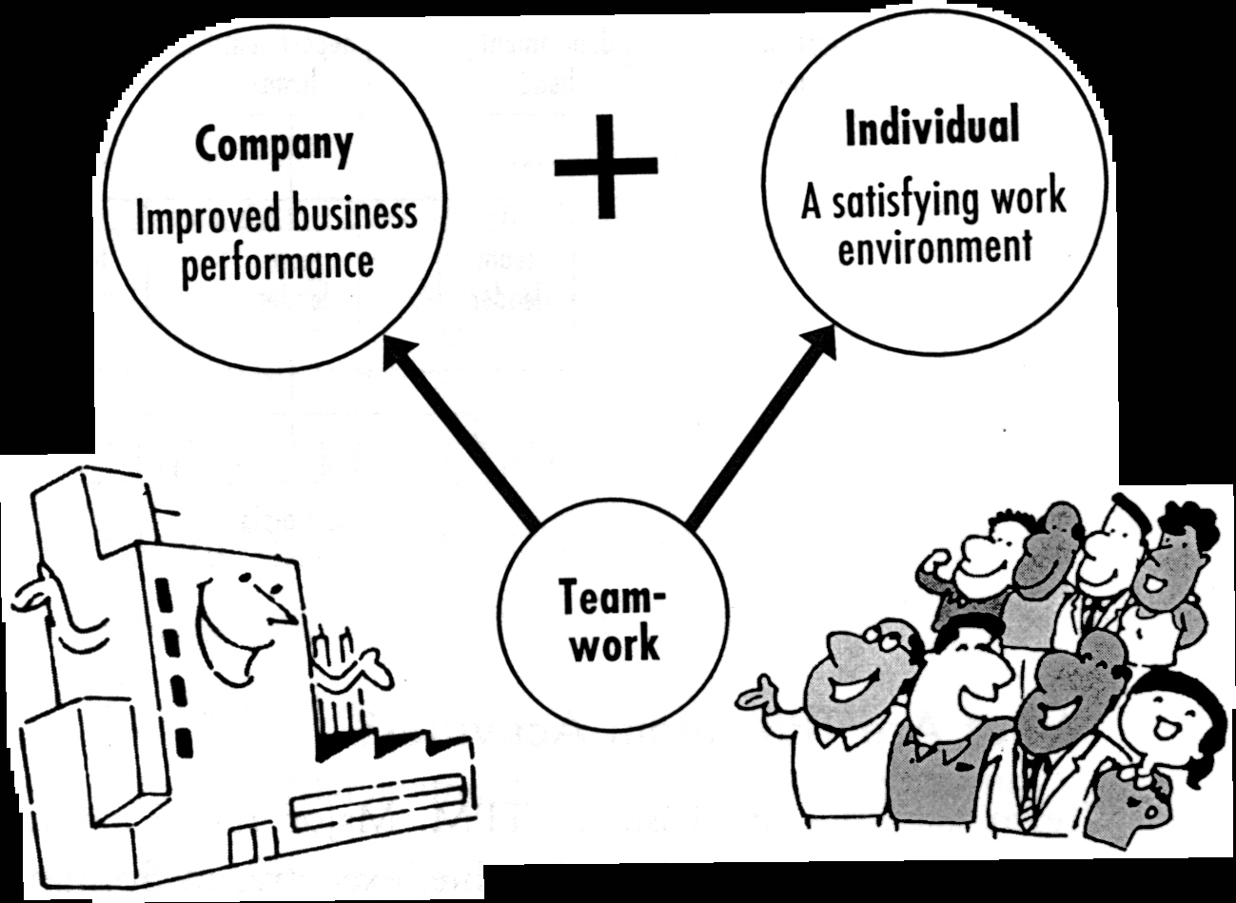

Slide 50


WHAT WILL I GAIN FROM TPM?
Work in groups
Positive attitude

Slide 51


WHAT WILL I GAIN FROM TPM?
Self confidence due to: Education & Training

Slide 52


WHAT WILL I GAIN FROM TPM?
Communication Skills
Creativity

Slide 53


WHAT WILL I GAIN FROM TPM?
Continuous improvement
Problem solving skills

Slide 54

WHAT WILL I GAIN FROM TPM?
11. Enthusiasm to work
13. Independent Maintenance

Slide 55


WHAT WILL I GAIN FROM TPM?
Sense of Achievement
Better health

Slide 56
Thanks

